Slide 1


GDPR - New EU Privacy Rules
Mike Hess
Data Protection Officer @ Connectify
mhess-connectify
Notes:
Newly Appointed DPO
After this week, some of you will be too

Slide 2
General Data Protection Regulation
(EU) 2016/679 is a regulation in EU law on data protection and privacy for all individuals within the European Union. It also addresses the export of personal data outside the EU. The GDPR aims primarily to give control to citizens and residents over their personal data and to simplify the regulatory environment for international business by unifying the regulation within the EU.

Slide 3

NOT IN EUROPE?
THIS STILL APPLIES TO YOU
(PROBABLY)
Notes:
I'm not here to waste your time

Slide 4
Also,

Slide 5

I AM NOT A LAWYER
YOU NEED A LAWYER
Notes:
What you need is a lawyer.
This is not an exhaustive list of all obligations, just some of the fun ones

Slide 6
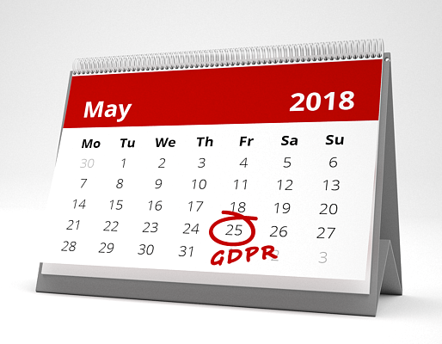
Why should you care?
Enforcement Starts May 25, 2018
Covers everyone processing data about anyone who is in Europe. Even if your company is not in Europe!
Fines of greater of 4% of revenue, 20 million euros!
Apple's updated privacy policy effectively enforces it now. If you have an app on the App Store, you better know about it.
As the person in charge of network security, database administration, and internal authentication, you're in a good position to perform most of the tasks of GDPR compliance
Notes:
Enforcement Starts May 25, 2018
Covers everyone processing data within the EU. Even if your company is not in europe!
Fines of greater of 4% of revenue, 20 million euros!
Apple's updated privacy policy enforces it now. If you have an app on the iTunes store, you better know about it.
As the person in charge of network security, database administration, and internal authentication, you're in a good position to perform most of the tasks of GDPR compliance
Don't be Experian/Facebook/Uber

Slide 7





Don't be like these guys
Notes:
Don't be like these guys

Slide 8

lol

Slide 9
What's new in the GDPR?
New Rights for Users
Right to know what's being collected
Right to be forgotten / erasure
Right to a copy of your personal data
Right to know what 3rd parties can see your data
New Obligations for Companies
Data minimization (collection and retention)
Data breach procedures
Transparent Privacy / Cookie Policy
3rd party data processors must also be compliant
New Job: Data Protection Officer
Notes:
New Rights for Users
Right to know what's being collected
Right to be forgotten / erasure
Right to a copy of your personal data
Right to know what 3rd parties can see your data
New Obligations for Companies
Data minimization (collection and retention)
Data breach procedures
Transparent Privacy / Cookie Policy
3rd party data processors must also be compliant
New Job: Data Protection Officer
Data Protection Authority in the EU

Slide 10
You need to assemble
a team
Notes:
You need to assemble ...A… team

Slide 11


Slide 12
What can your DevOps team do to get ready?
Make sure the company knows about it (they need a lawyer)
Read ICO's 12 Steps for Compliance
Conduct a data audit
Conduct a data security audit
Evaluate Purpose of Data Collection
How is data used?
What is your legal basis for collection?
Legitimate use
Contract
Consent
Notes:
Make sure the company knows about it (they need a lawyer)
Read ICO's 12 Steps for Compliance
Conduct a data audit
Log files
Databases
Data Warehouses / BI
S3 Buckets
Conduct a data security audit
Data in transit
Data at rest
Who has access at your company?
Any random database snapshots laying around?

Slide 13
What should the rest of the team do to become compliant?
What the Rest of the Team Needs to Do
Update your privacy policy
Inform users in App UI, website, and/or through email communications
Make sure your 3rd parties / data customers are GDPR compliant
Notes:
What the Rest of the Team Needs to Do
Update your privacy policy
Inform users in App UI, website, and/or through email communications
Make sure your 3rd parties / data customers are GDPR compliant

Slide 14
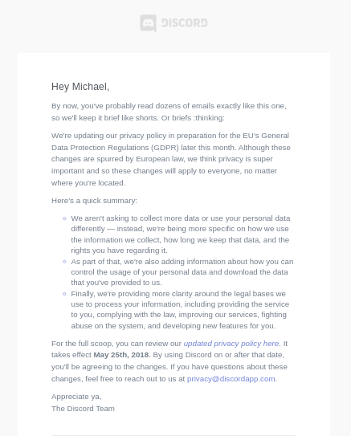
What should the rest of the team do to become compliant?
Notes:
What the Rest of the Team Needs to Do
Update your privacy policy
Inform users in App UI, website, and/or through email communications
Make sure your 3rd parties / data customers are GDPR compliant

Slide 15
How do I stay compliant?
GDPR doesn't end on May 25th
Need to appoint (or contract) a Data Protection Officer
Improve processes for guaranteeing user rights under GDPR
Notes:
GDPR doesn't end on May 25th
Need to appoint (or contract) a Data Protection Officer
Point of contact for data privacy questions
Responsible for maintaining privacy protection procedures
Provides compliance advice on new data collecting technologies
Need ongoing data breach monitoring and reporting
Improve processes for guaranteeing user rights under GDPR
Better (automated) deletion process
Pseudonymisation
Better auditing of internal data access

Slide 16
Resources
UK Information Commissioner's Office: 12 Steps to Take Now https://ico.org.uk/for-organisations/guide-to-the-general-data-protection-regulation-gdpr/
UK Federation of Small Business GDPR Video https://www.fsb.org.uk/resources/are-you-gdpr-ready/
Paypal: GDPR For Smaller Organizations https://www.paypal.com/stories/uk/gdpr-for-smaller-organisations/
Speedify Privacy Policy http://speedify.com/privacy-policy

Slide 17
Questions?
Mike Hess
Data Protection Officer @ Connectify
Notes:
Newly Appointed DPO
After this week, some of you will be too

